Slide 1

Assignment on Arrays
By
M. Mary Margarette

Slide 2
Arrays :
Arrays are collections of similar data types.
Array index starts from zero.
Array variable size = Array length * data type size.
Array size cannot be increased dynamically.
Arrays require sequential memory location.
It is not mandatory to mention size while initializing arrays.

Slide 3

Searching:
Searching is a topic of "Data structures".
It is used to find an element in the given array through searching techniques.
Two popular searching techniques are Linear Search and Binary Search.

Slide 4
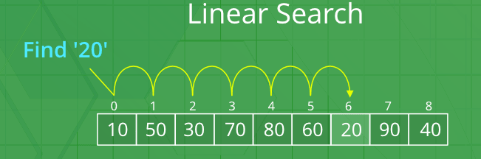
Linear Search
Linear search is also called as sequential search algorithm.
In Linear search, we simply traverse the list completely.
We match each element of the list with the item whose location is to be found.
Until required element and element in the list are same.
Or else it will give output as Number not found.

Slide 5
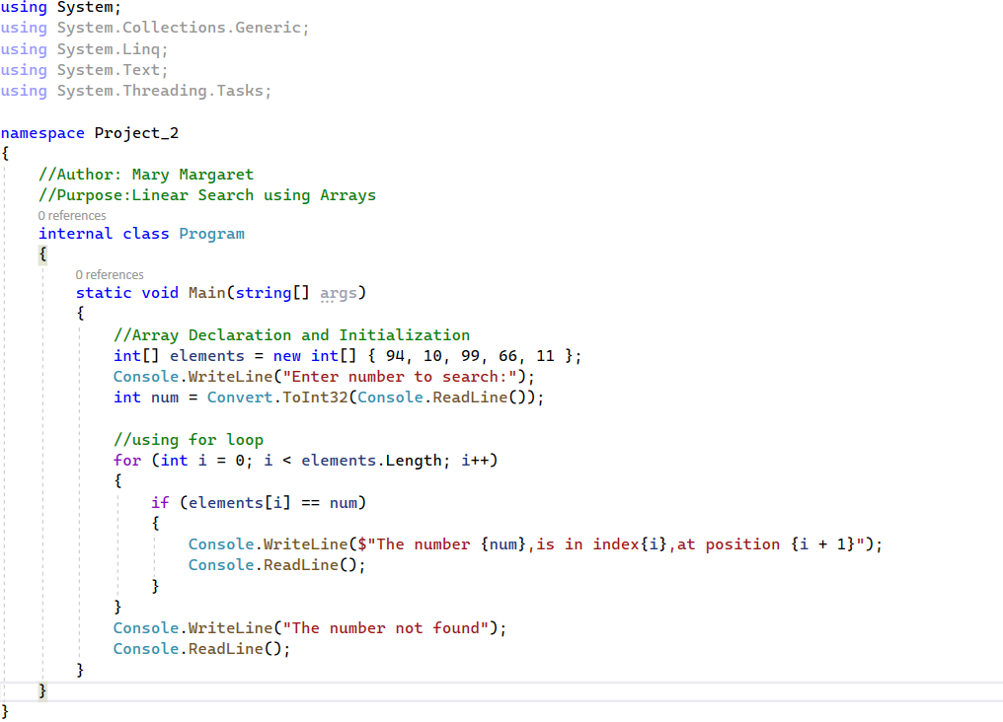
Code :

Slide 6
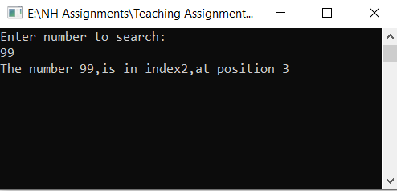
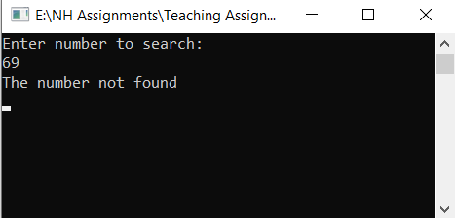
OUTPUT :
Output gives number searched, index of the number in Array, and position of element in the Array.
Output shows that number is not found from the Array initialized.

Slide 7
Binary Search
Binary search is the search technique that works on sorted lists/Arrays.
For this type of searching, we must ensure that list is sorted.
There are two methods to implement the binary search algorithm
Iterative method
Recursive method

Slide 8
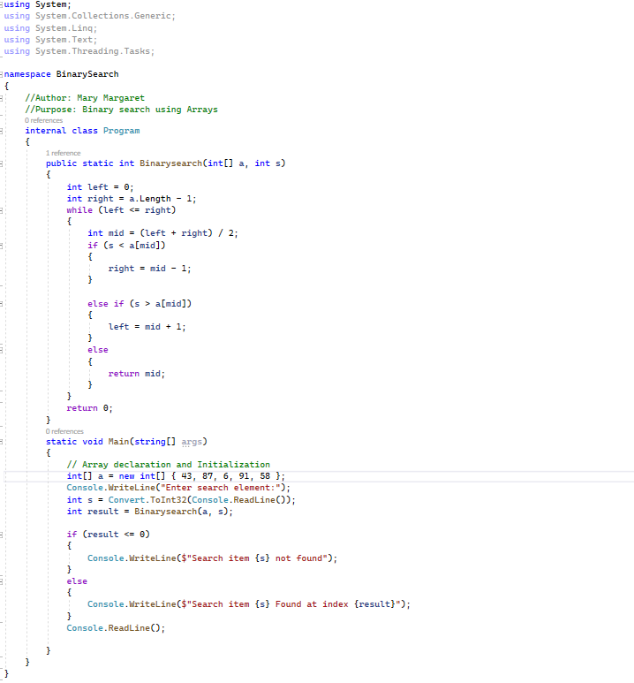
CODE :

Slide 9
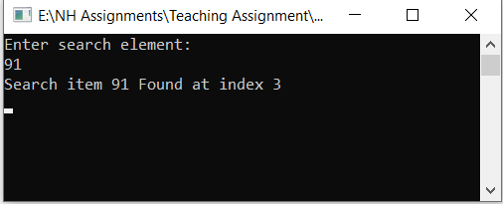
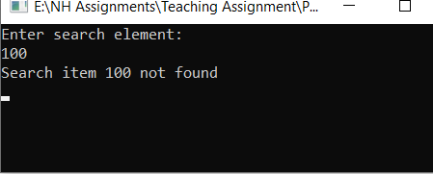
OUTPUT :
Output shows index of the number in the list if it is in the Array.
Output shows as Search item is not found from the Array initialized.

Slide 10
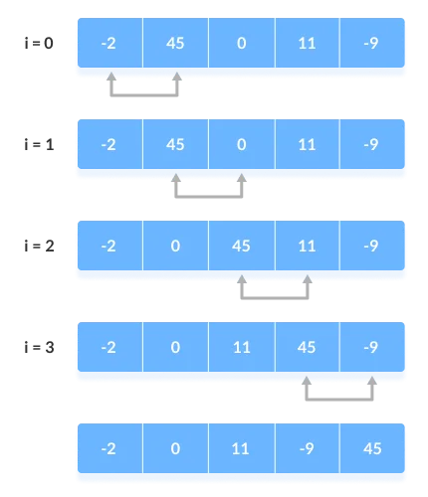
Bubble Sort
Bubble sort works on swapping of elements until they are in order.
It is not suitable for large data sets.
Bubble sort is used where simple and short code is preferred.

Slide 11
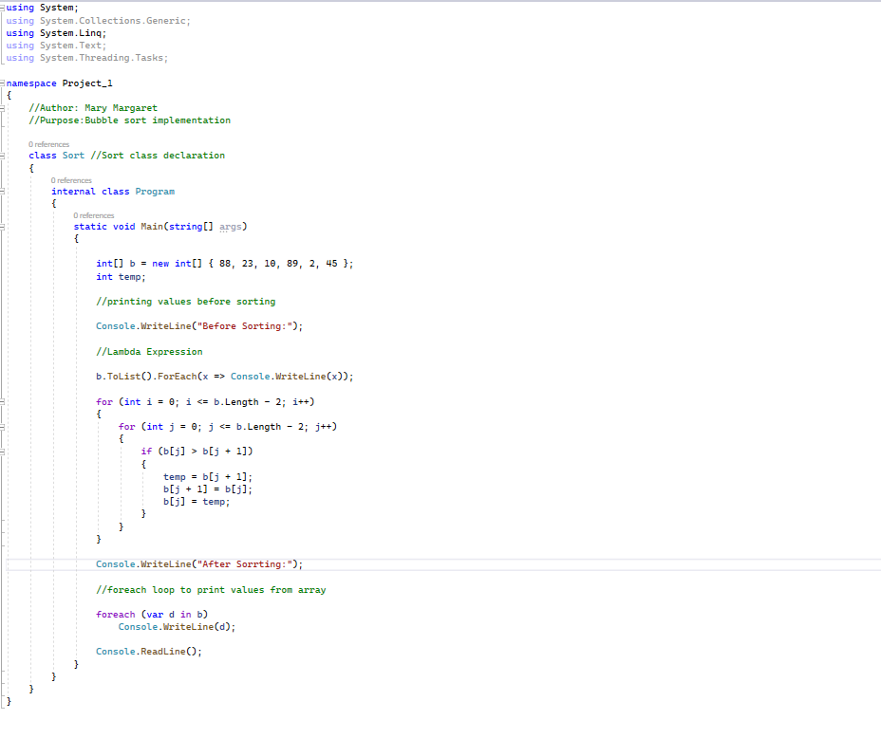
Code:

Slide 12
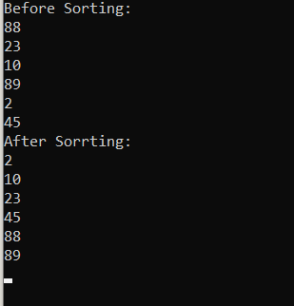
OUTPUT :
Output before sorting is not in order.
88 23 10 89 2 45
Output after sorting is in order.
2 10 23 45 88 89

Slide 13
THANK YOU

